Slide 1
Pi Approximation Variants
Report by:
Mark Christian Liwag

Slide 2
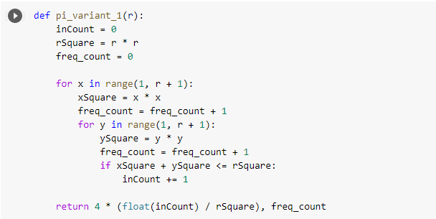
PI Variant 1
Code: Using only one quadrant, where x-y pairs are draws from values 0 to r
Input size here refers to r^2, where r is used to generate x and y in the nested for loop to approximate the area of the circle.
Frequency count is initialized to zero and is incremented in nested for loop. Other code statements are disregarded in frequency count since for analysis of algorithms course, and in computation of time complexity, frequency count in nested for loop in this case is sufficient since it reflects time complexity. Basic operation in the code is instead counted.

Slide 3
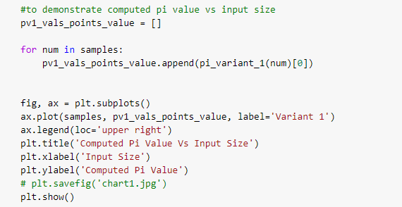
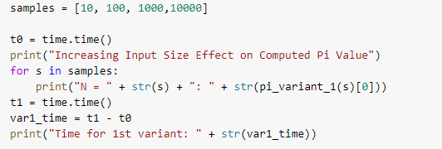
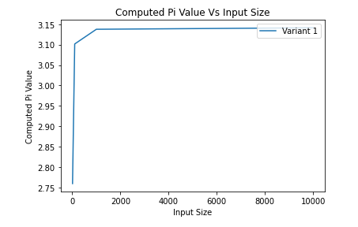
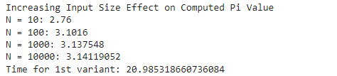
PI Variant 1
Effect of Increasing Input Size on Computed Pi Value
Output
Conclusion: Increasing the input size (by increasing the value of r as shown by increasing values in the samples list) leads to a better approximation of pi as seen at N = 10000 compared to N = 10 and seen also from the graph shown above. The graph shows an asymptotic curve to 3.14 as input size increases demonstrating the calculated value gets closer to pi.

Slide 4
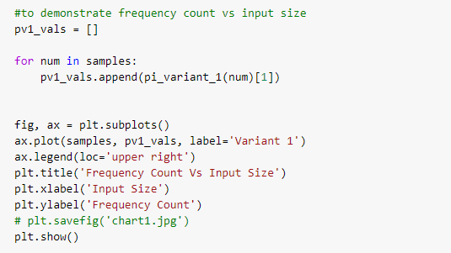
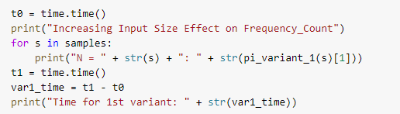
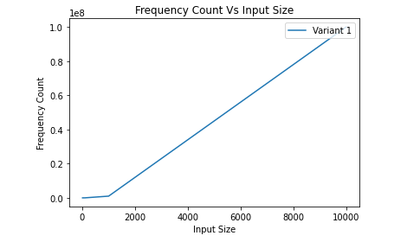
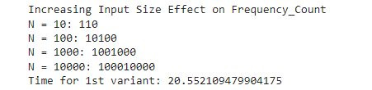
PI Variant 1
Effect of Increasing Input Size on Frequency Count
Output
Conclusion: Increasing the input size (by increasing the value of r as shown by increasing values in the samples list) leads to higher frequency count as seen at N = 10000 (where frequency count is 100010000) compared to N = 10 (where frequency count is 110) and seen also from the graph shown above. The graph shows the increasing trend in frequency count as the input size increases

Slide 5
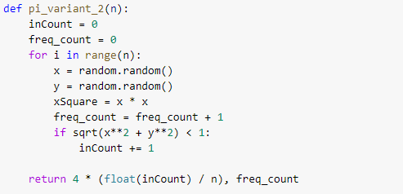
PI Variant 2
Code: Random picking N pairs of real numbers in the range(0,1) for both x and y.
Input size here refers to n, where n is the number of points that are used to approximate the area of the circle. It is O(n).
Frequency count is initialized to zero and is incremented in for loop. Other code statements are disregarded in frequency count since for analysis of algorithms course, and in computation of time complexity, frequency count in for loop in this case is sufficient since reflects time complexity. Basic operation in the code is instead counted.

Slide 6
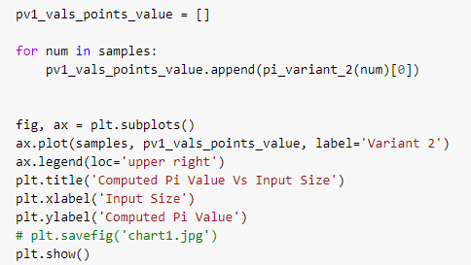
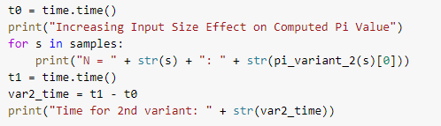
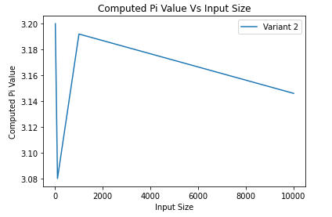
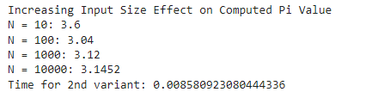
PI Variant 2
Effect of Increasing Input Size on Computed Pi Value
Output
Conclusion: Increasing the input size (by increasing the value of n as shown by increasing values in the samples list) leads to a better approximation of pi as seen at N = 10000 compared to N = 10 and seen also from the graph shown above. The graph shows stark contrast to pi variant’s 1 graph. The reason is that pi variant 2 relies on random values where its possible that more elements get inside the arc in small N, as compared to variant 1, where input values go from 1 to r in a systematic, increasing fashion. The randomness impact disappears with increasing input size consistent with central limit theorem, where in large values, the central tendency represents true value, in this case, the value of pi.

Slide 7
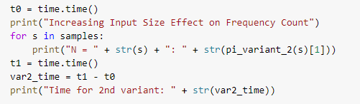
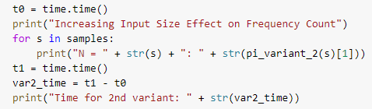
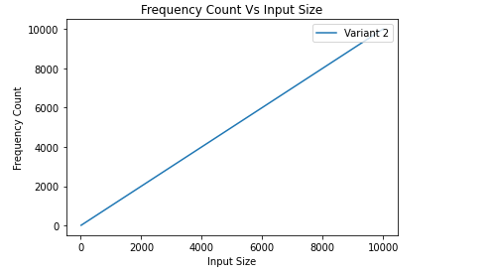
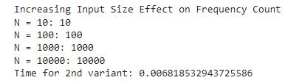
PI Variant 2
Effect of Increasing Input Size on Frequency Count
Output
Conclusion: Increasing the input size (by increasing the value of n as shown by increasing values in the samples list) leads to higher frequency count as seen at N = 10000 (where frequency count is 10000) compared to N = 10 (where frequency count is 10) and seen also from the graph shown above. The graph shows the increasing trend in frequency count as the input size increases.

Slide 8
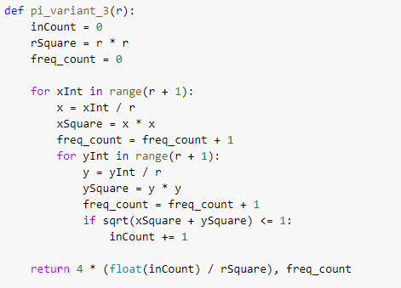
PI Variant 3
Code: Combine variants 1 and 2, where integer pairs are converted to real number equivalent in the range (0,1) by dividing x and y integer values by r.
Input size here refers to r^2, where r is used to generate x and y in the nested for loop to approximate the area of the circle.
Frequency count is initialized to zero and is incremented in nested for loop. Other code statements are disregarded in frequency count since for analysis of algorithms course, and in computation of time complexity, frequency count in nested for loop in this case is sufficient since it reflects time complexity. Basic operation in the code is instead counted.

Slide 9
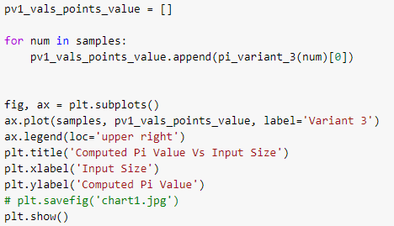
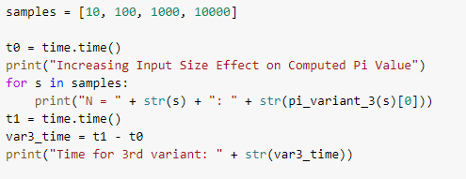
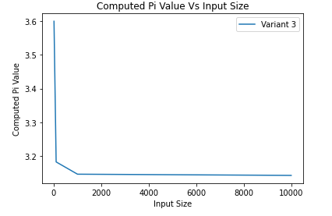
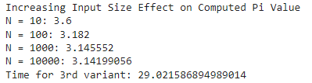
PI Variant 3
Effect of Increasing Input Size on Computed Pi Value
Output
Conclusion: Increasing the input size (by increasing the value of r as shown by increasing values in the samples list) leads to a better approximation of pi as seen at N = 10000 compared to N = 10 and seen also from the graph shown above. The graph shows computed pi value staying at approximately 3.14 as input size increases demonstrating the calculated value gets closer to pi as input size increases.

Slide 10
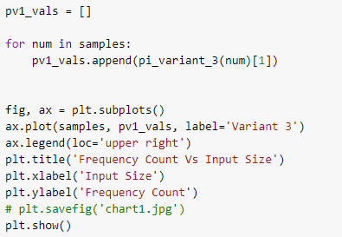
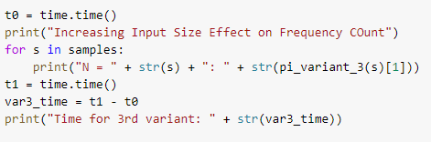
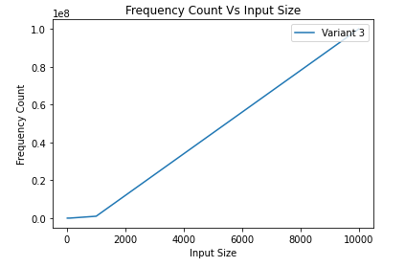
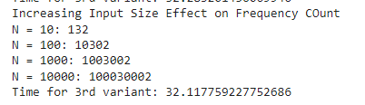
PI Variant 3
Effect of Increasing Input Size on Frequency Count
Output
Conclusion: Increasing the input size (by increasing the value of r as shown by increasing values in the samples list) leads to higher frequency count as seen at N = 10000 (where frequency count is 100030002) compared to N = 10 (where frequency count is 110) and seen also from the graph shown above. The graph shows the increasing trend in frequency count as the input size increases

Slide 11
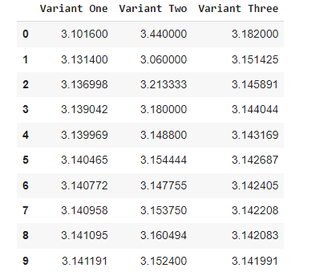
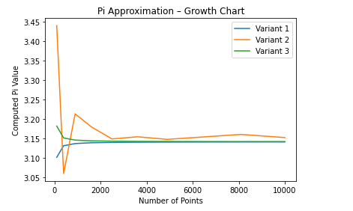
Comparison of Variants for Calculated Pi Value
Conclusion: Variant 1 and Variant 3, manage to approximate pi value closer because of its systematic generation of points to r, whereas Variant 2 is random in generation of its points (some points more inside arc than outside and vice versa), only getting closer to pi value at larger points since large values evens out the randomness aspect caused by Variant 2.

Slide 12
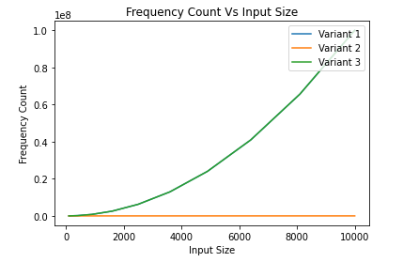
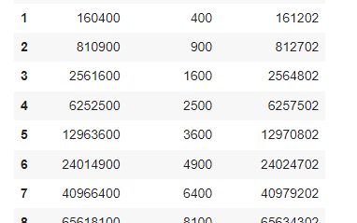
Comparison of Variants for Frequency Count
Conclusion: Variant 2’s frequency count is smaller since you are computing the number of N, whereas in Variant 1, 3, the r does not represent the number of points, but r^2 that represents the number of points. The size of the input is r^2, making the frequency count larger.

Slide 13
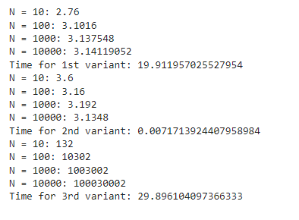
Comparison of Variants for Time Complexity
Conclusion: Variant 2 is faster since you are computing the number of N, whereas in Variant 1, 3, the r does not represent the number of points, but r^2 that represents the number of points. The size of the input is r^2, making it slower.

